Slide 1



Steps forward in restoration prioritization
Jeffrey Hanson
jeffrey.hanson@uqconnect.edu.au
jeffrey-hanson.com

Slide 2



Ecological surveys
Distribution maps
Priority areas
Biodiversity
2000
Future
Data
Information
Plan
Outcome
Objectives
Constraints

Slide 3
Ecological surveys
Distribution maps
Priority areas
Biodiversity
2000
Future
Data
Information
Plan
Outcome
Objectives
Constraints
Where are the biggest challenges in restoration prioritization?

Slide 4
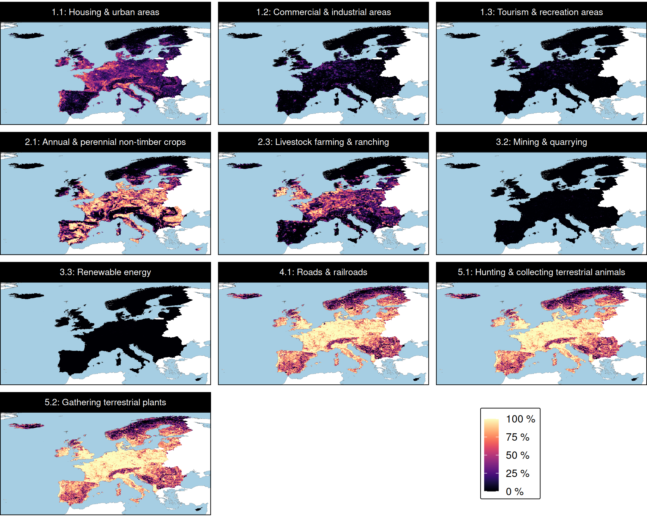
Threats
We need data for:
What threats are feasible to manage to
through conservation actions?
Which of these actions involve habitat restoration?
Hanson et al. In prep

Slide 5
Threats
P
P
We need data for:
What threats are feasible to manage to
through conservation actions?
P = Permanent
Which of these actions involve habitat restoration?
R = Restoration
R
R
R
P
Hanson et al. In prep

Slide 6
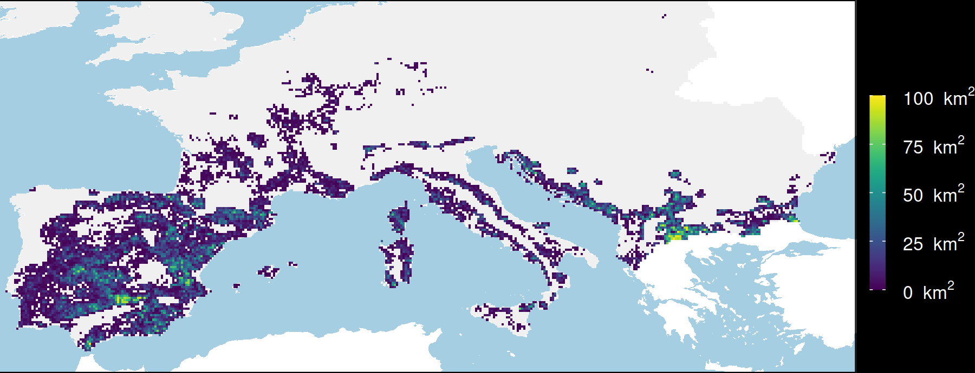

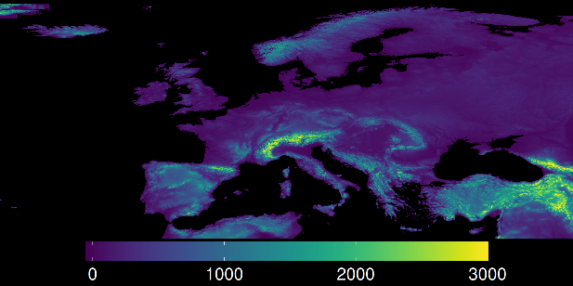
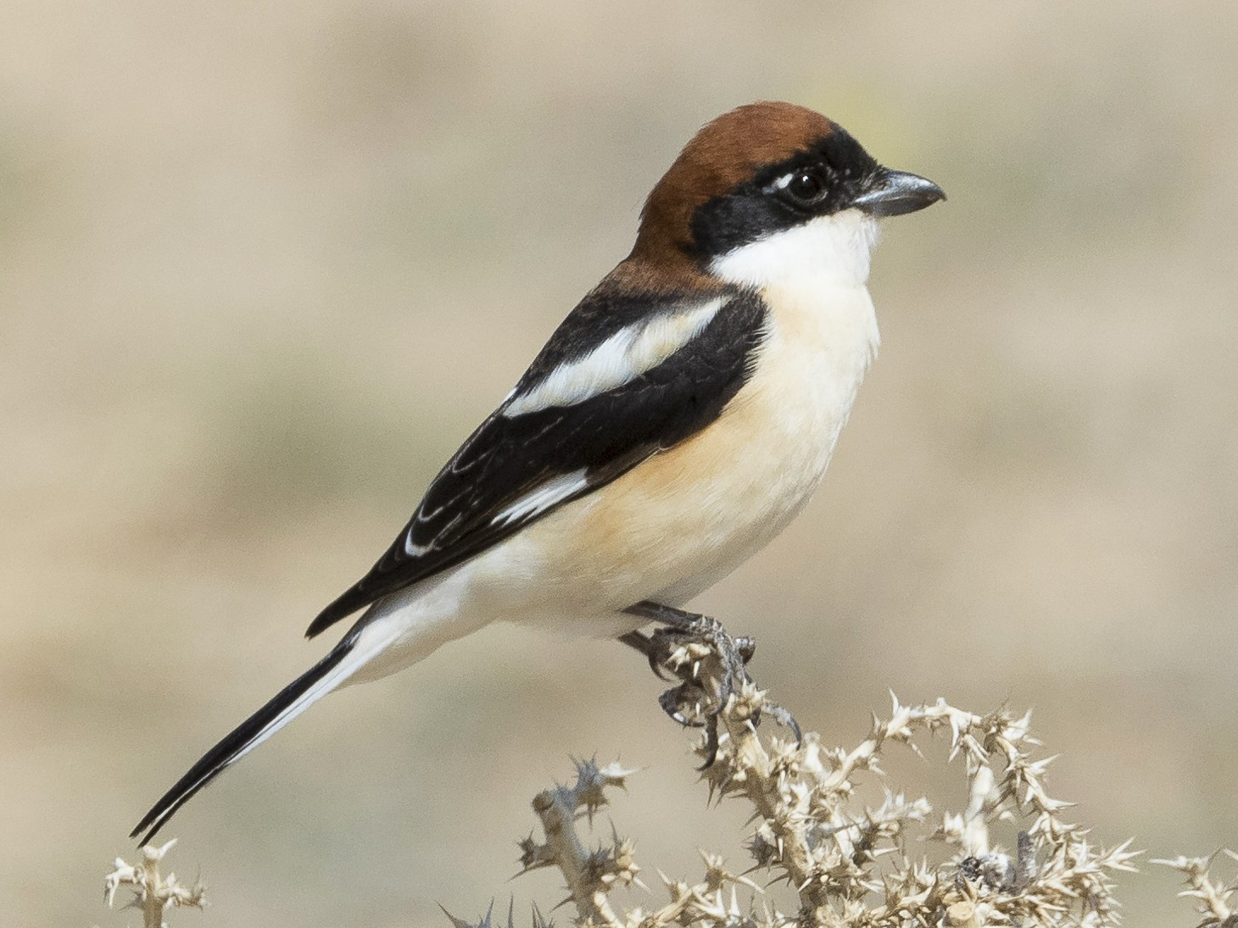
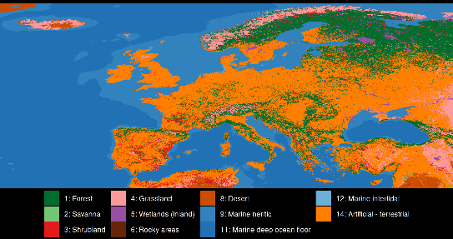
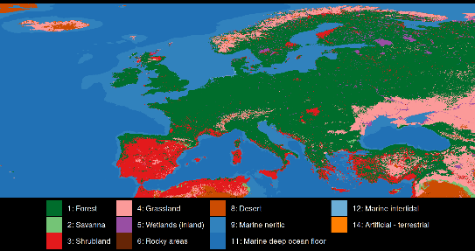
Mapping consequences of conservation actions
Protect existing habitat
Species
Elevation
Woodchat Shrike
Threats
What if?
Current
land cover
Potential natural
vegetation
Hanson et al. In prep

Slide 7

Mapping consequences of conservation actions
Existing habitat
Species
Elevation
Woodchat Shrike
Restore croplands
Threats
What if?
Current
land cover
Potential natural
vegetation
Hanson et al. In prep

Slide 8
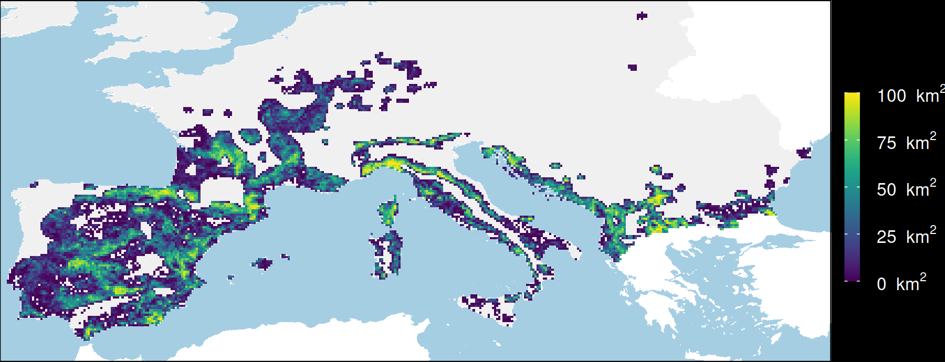
Mapping consequences of conservation actions
Existing habitat
Species
Elevation
Woodchat Shrike
Restore croplands
Threats
What if?
Stop hunting
Current
land cover
Potential natural
vegetation
Hanson et al. In prep

Slide 9
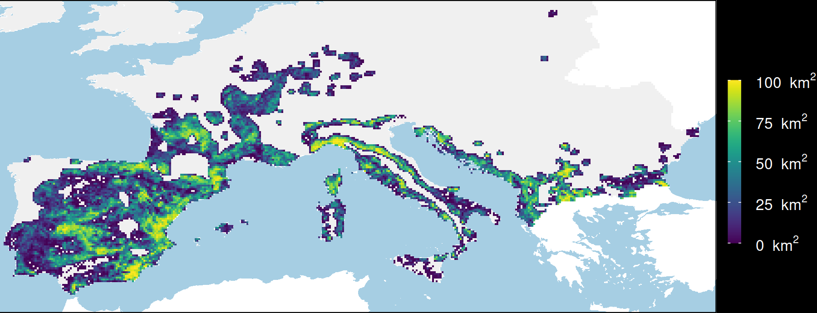
Mapping consequences of conservation actions
Existing habitat
Species
Elevation
Woodchat Shrike
Restore croplands
Threats
What if?
Stop hunting
Current
land cover
Potential natural
vegetation
Restore croplands
& stop hunting
Hanson et al. In prep

Slide 10
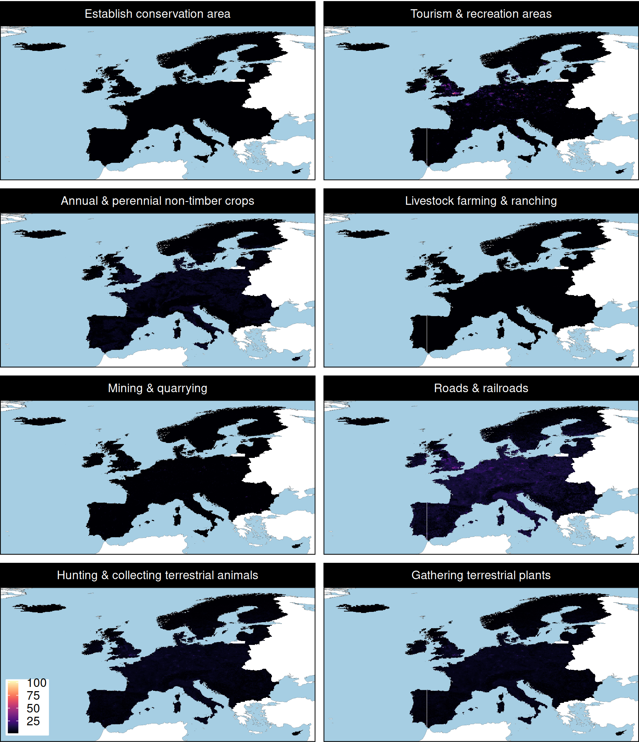
Mapping costs of actions
This is HARD
Costs need to be spatially explicit
Costs need to be comparable across different actions/threats (e.g., cheaper to restore threat A vs. threat B)
Account for existing management (e.g., cheaper in protected areas)
Account for existing state (e.g., cheaper in high quality forests vs. low quality forests)

Slide 11
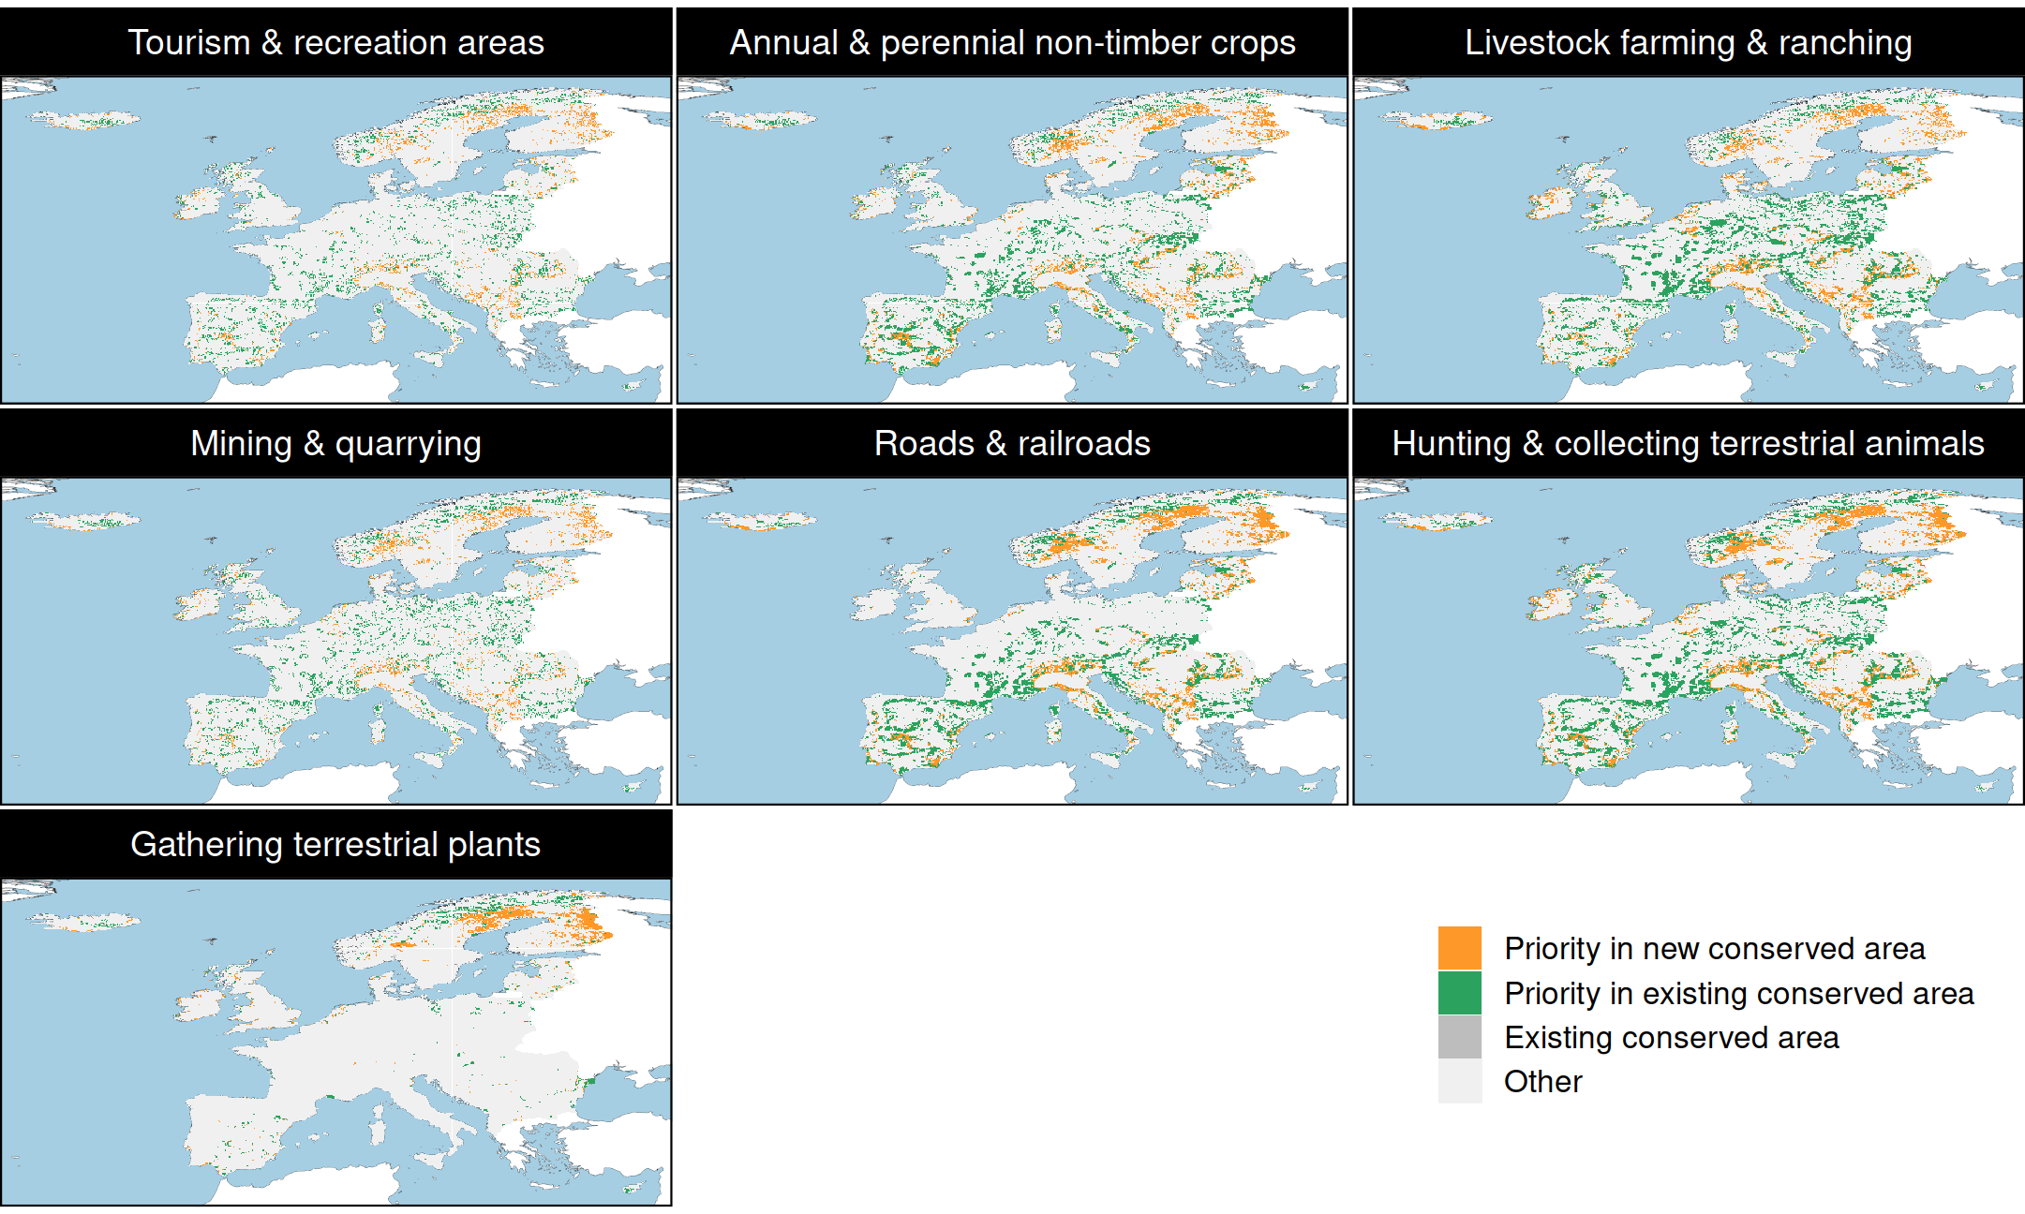
Prioritization to manage threats
R
R
R
Hanson et al. In prep

Slide 12
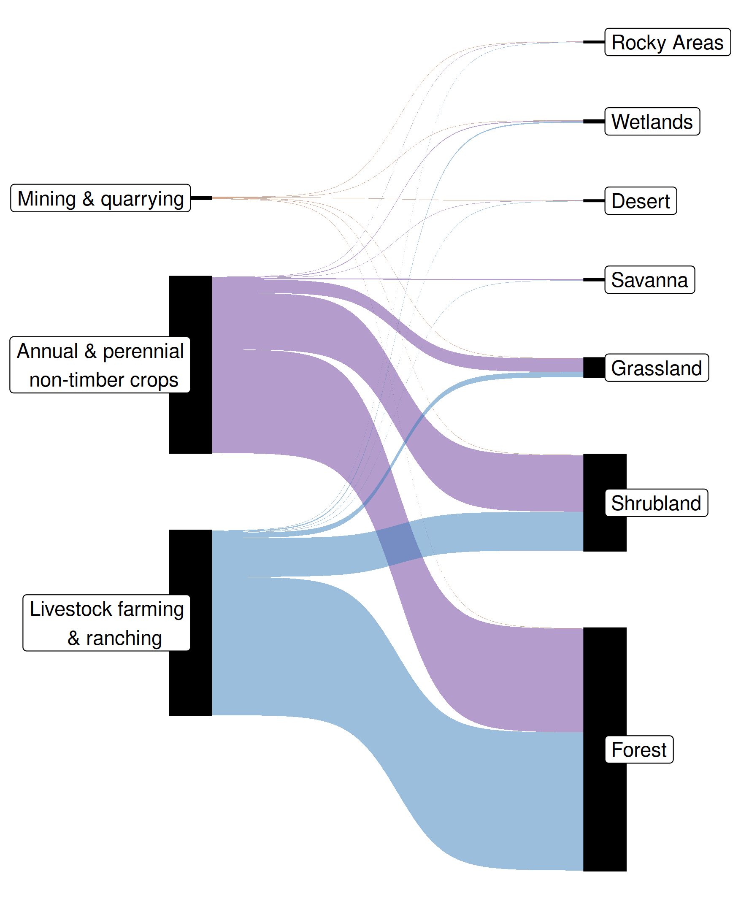
Habitat restoration from threat management
R
R
Hanson et al. In prep

Slide 13
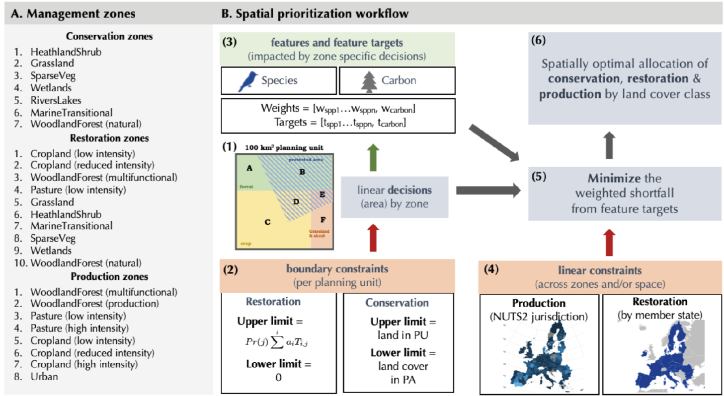
Adding more complexity
Multiple categories of zones (e.g., conservation, restoration, production)
Multiple restoration options in the same place (e.g., we will restore planning unit A to grassland or wetlands)?
Ecosystem services (e.g., carbon sequestration)
Chapman et al. 2023 OSF Preprint

